Slide 1
Lecture 25: LM3S9B96 Microcontroller – Watchdog Timer

Slide 2
Stellaris® LM3S9B96 Microcontroller
Data Sheet
Chapter 12
Watchdog Timers

Slide 3
Watchdog Timer (WDT)
The watchdog timer is used to re-gain control when a system has failed due to a software error or due to the failure of an external device to respond in the expected way.
A watchdog timer can generate a NMI or a reset when a time-out value is reached.
The LM3S9B96 microcontroller has two Watchdog Timer Modules
Watchdog Timer 0 is clocked by the system clock
Watchdog Timer 1 is clocked by the PIOSC
Watchdog Timer can be configured to generate an interrupt to the microcontroller on its first time-out, and to generate a reset signal on its second time-out.

Slide 4
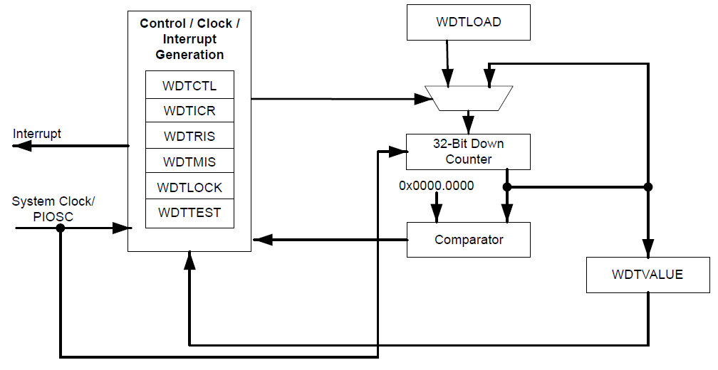
Block Diagram

Slide 5
Functional Description
After being enabled, the WDT generates the first time-out signal when the 32-bit counter reaches 0
Enabling the counter also enables the watchdog timer interrupt
After the first time-out event, the value of the Watchdog Timer Load (WDTLOAD) register is re-loaded
Once the WDT has been configured, the Watchdog Timer Lock (WDTLOCK) register can be written to prevent the timer configuration from being altered by software

Slide 6
Functional Description
If the timer counts down to zero again before the first time-out interrupt is cleared, and the reset signal has been enabled by setting the RESEN bit in the WDTCTL register, the WDT will asserts its reset signal to the system
If the interrupt is cleared before the 32-bit counter reaches its second time-out, the 32-bit counter is loaded with the value in the WDTLOAD register, and counting resumes from that value.
If WDTLOAD is written with a new value while the Watchdog Timer counter is counting, the counter is loaded with the new value and continues counting
An interrupt must be specifically cleared by writing to the Watchdog Interrupt Clear (WDTICR) register
When the WDT interrupt and reset generation is enabled, counter is preloaded with the load register value

Slide 7
Register Access Timing for WDT1
WDT1 has an independent clocking domain (not using the system clock), its registers must be written with a timing gap between accesses
The WRC bit in the Watchdog Control (WDTCTL) register for WDT1 indicates that the required timing gap has elapsed
This bit is cleared on a write operation and set once the write completes
Software should poll WDTCTL for WRC=1 prior to accessing another register

Slide 8
Initialization and Configuration
To use the WDT, its peripheral clock must be enabled by setting the WDT bit in the RCGC0 register
The Watchdog Timer is configured using the following sequence:
1. Load the WDTLOAD register with the desired timer load value
2. If WDT1, wait for the WRC bit in the WDTCTL register to be set.
3. If the WDT is configured to trigger system resets, set the RESEN bit in the WDTCTL register
4. If WDT1, wait for the WRC bit in the WDTCTL register to be set.
5. Set the INTEN bit in the WDTCTL register to enable the Watchdog and lock the control register.
Writing any value to the WDTLOCK register will fully lock the WDT; to unlock the Watchdog Timer, write a value of 0x1ACCE551

Slide 9
Register Map
The Watchdog Timer base address:
WDT0: 0x4000.0000
WDT1: 0x4000.1000
Table 12-1 on page 484 lists the Watchdog registers.

Slide 10
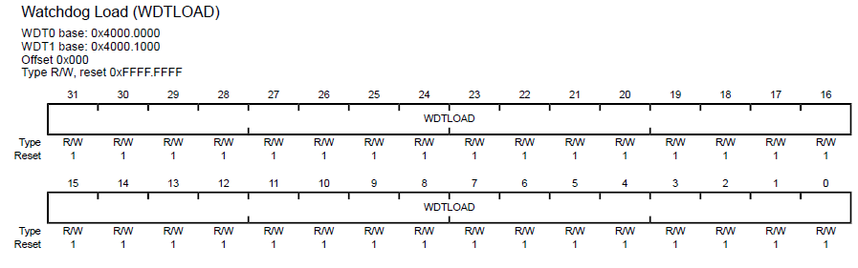
Register Description: Watchdog Load (WDTLOAD)
This register is the 32-bit interval value used by the 32-bit counter. When this register is written, the value is immediately loaded and the counter restarts counting down from the new value. If the WDTLOAD register is loaded with 0x0000.0000, an interrupt is immediately generated.

Slide 11
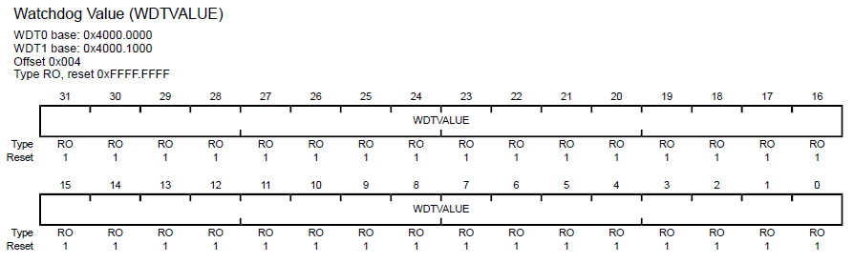
Register Description: Watchdog Value (WDTVALUE)
This register contains the current count value of the timer.

Slide 12
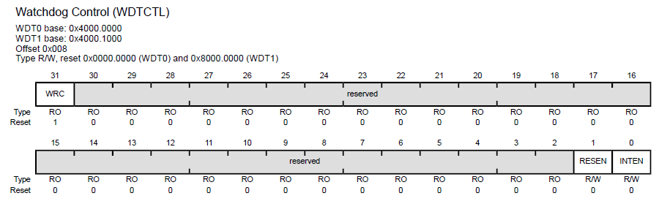
Register Description: Watchdog Control (WDTCTL)
This register is the watchdog control register.
When the watchdog interrupt has been enabled, all subsequent writes to the control register are ignored. The only mechanism that can re-enable writes is a hardware reset.

Slide 13
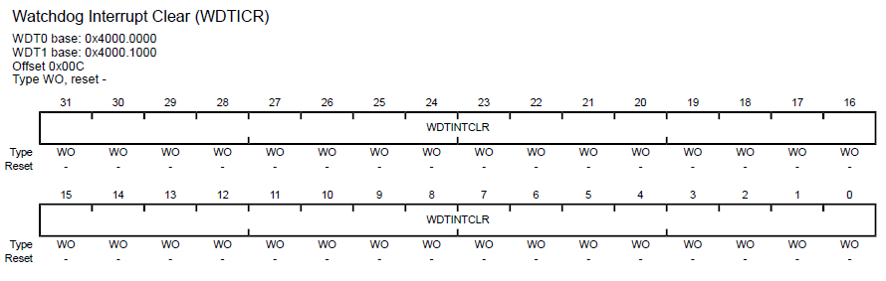
Register Description: Watchdog Interrupt Clear (WDTICR)
This register is the interrupt clear register. A write of any value to this register clears the Watchdog interrupt and reloads the 32-bit counter from the WDTLOAD register.

Slide 14
Register Description: Other Registers
Watchdog Raw Interrupt Status (WDTRIS)
Watchdog Masked Interrupt Status (WDTMIS)
Watchdog Lock (WDTLOCK)
Watchdog Test (WDTTEST)

